Slide 1

Predicting Coupon Acceptance on E Commerce Platform
The goal of this project is to leverage machine learning techniques to analyze driving scenarios and user attributes collected from an e-commerce website. By accurately predicting whether users will accept coupons during their journeys, the aim is to optimize coupon distribution strategies and enhance user engagement with the platform's offerings. The survey describes different driving scenarios including the user’s destination, weather, passenger, coupon attributes, user attributes, and contextual attributes, and then asks the user whether he/she will accept the coupon or not.

Slide 2


Data Overview
1
Dataset Size
12,684 rows and 25 columns available in the dataset. Size of
the dataset is 317100
2
Key Features
exipry, temperature, coupon coffee house are important features of the dataset
3
Target Variable
“Accept” – categorical column describing coupon accepted by
user or not .

Slide 3
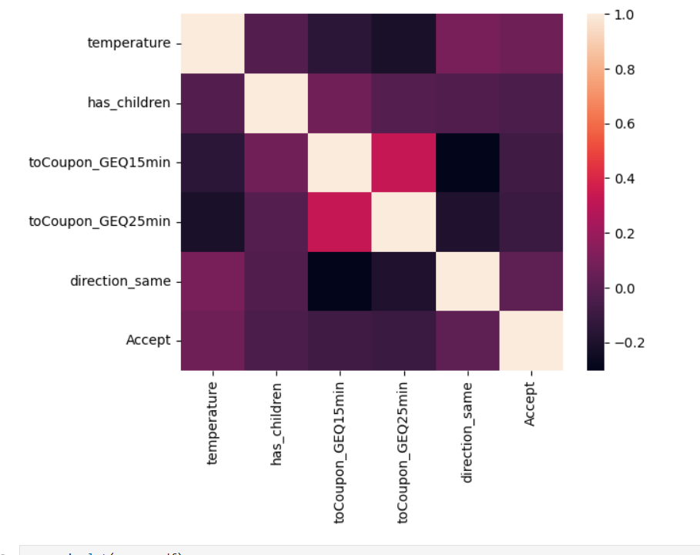
Data Preprocessing
1
Handling Missing Values
Dataset contains missing values in categorical columns . Mode value of the respective column is used for imputation of missing values
2
Outlier and duplicate values
Dataset does not contain outliers. Dataset consists of 291 duplicate values which is dropped before preparing a model
3
Feature Engineering
Dataset consists of mostly categorical values hence feature scaling is not required however categorical columns are transferred to numerical values with one hot encoding using pandas.

Slide 4
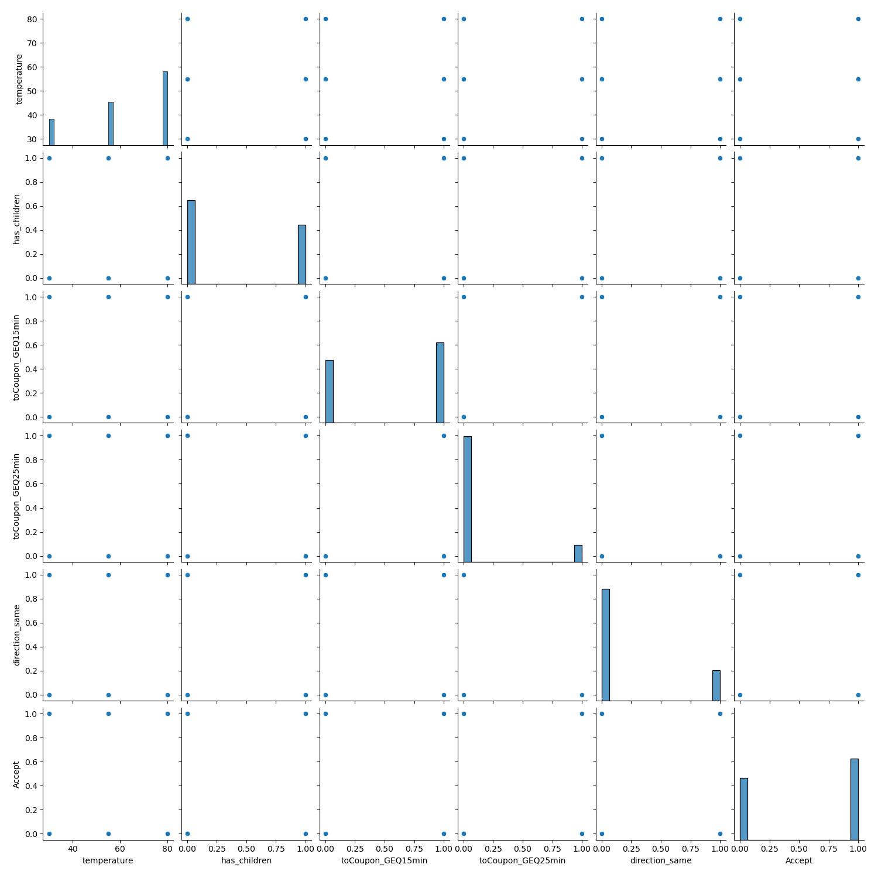
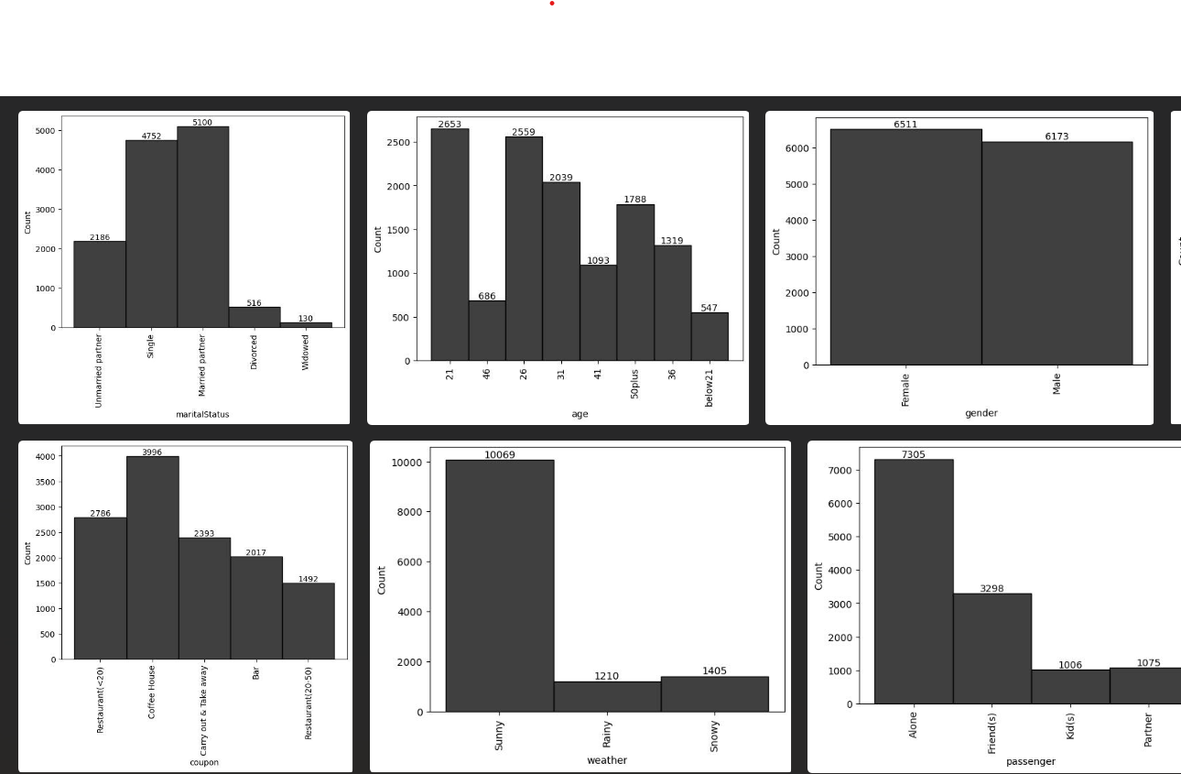
Exploratory Data Analysis
Correlation Analysis
Distribution Plots
Scatter Plots
Heatmap revealed relationships between variables, guiding feature selection.
Various graphs showed data distributions, helping identify potential issues.
Pairwise scatter plots highlighted relationships between features and target variable.

Slide 5
Observations from Dataset
79% of the time weather is Sunny
Coupon acceptance ratio is more for the users below 21 years of age
In the category of passenger, Friends are having highest coupon acceptance percentage
Coupon acceptance ratio is highest if destination is “No Urgent Place”
Target variable consists of more “ Yes” values however data is not highly imbalanced
During high temperatures users accepted more coupon
“Carryout and Take away” coupon category has highest coupon acceptance and “Bar” is having least coupon acceptance ratio
Users accepted more coupon if the validity of coupon is 1 day
Male has high percentage of coupon acceptance than female
Retired employees shows least interest in accepting the coupon in percentage
Less income users accepted more coupons than others in percentage
Users without children have high percentage of coupon acceptance
people who visits Bar between 1 to 3 times in a months is having high coupon acceptance ratio

Slide 6
Model Selection
Linear Models
Tree-based Models
Advanced Models
Logistic Regression for baseline performance.
Decision Tree and Random Forest for capturing non-linear relationships.
Support Vector Classifier and XGBoost for potentially higher accuracy.

Slide 7
Model Training and Evaluation
Data Splitting
Performance Metrics
80% training, 20% testing split for model evaluation.
Evaluated models using Accuracy score, Precision, Recall, F1-Score and Confusion Matrix.
1
2
3
Hyperparameter Tuning
Used RandomizedSearchCV to optimize model parameters.

Slide 8
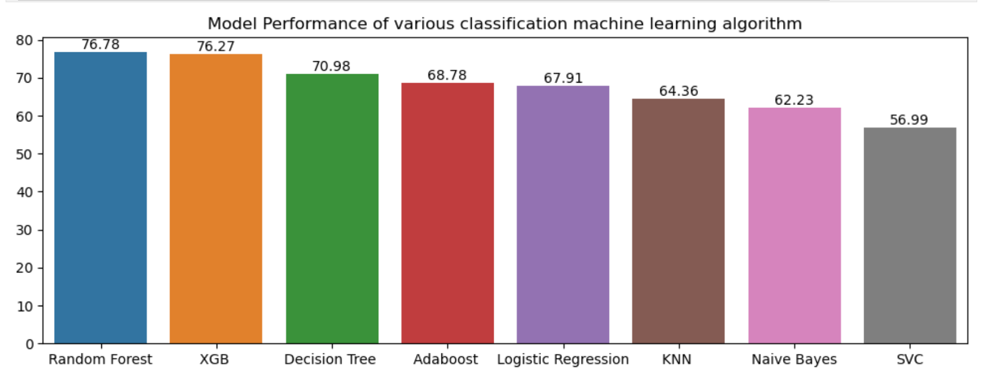
Model Performance Comparison
Best Performer
Runner-up
Worst Performer
Random Forest Classifier achieved highest accuracy score of 76.78%.
XGBoost Regressor came second with 76.27%
Support Vector Classifier performed poorly .

Slide 9

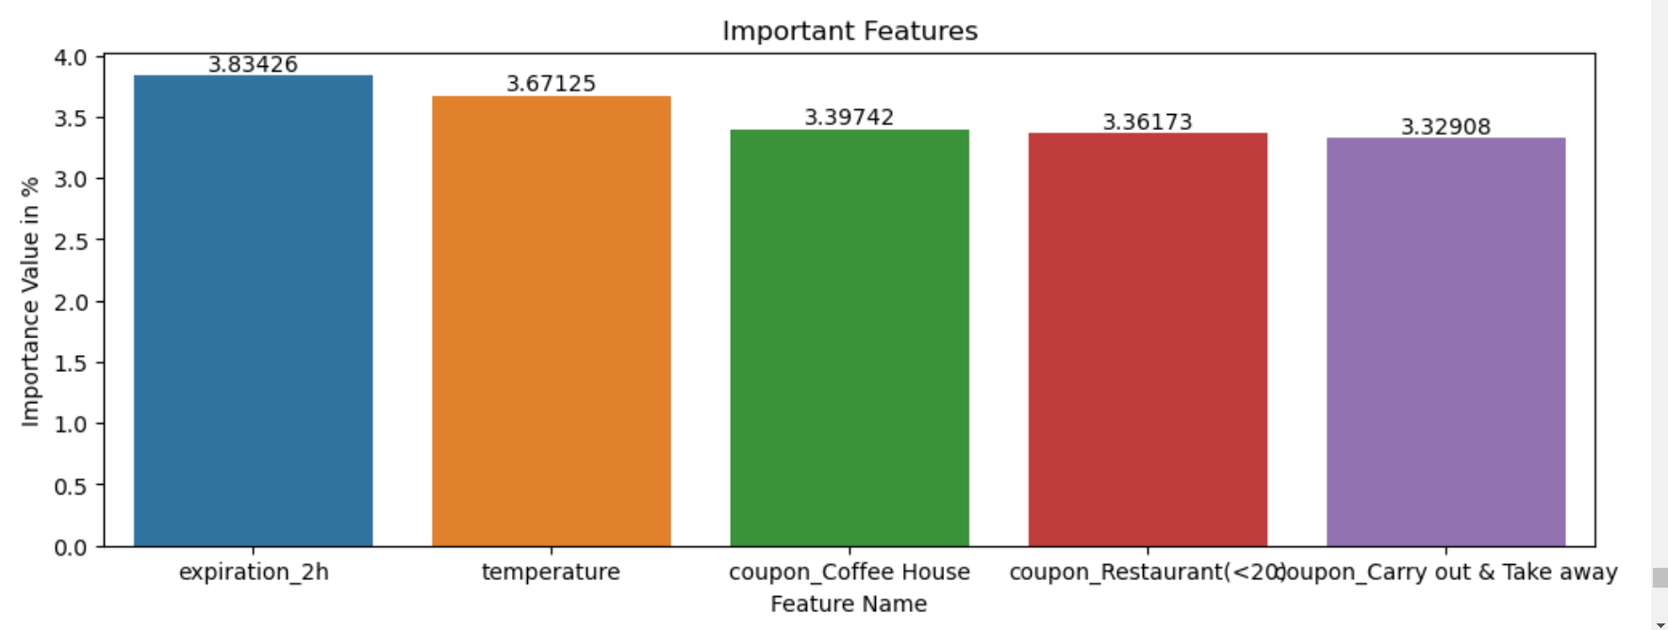


Feature Importance
Expiration-2h
Most important feature with 3.83% importance.
temperature
Second most important at 3.67%.
Coupon coffee house
Third most important features with 3.39%.

Slide 10

Key Findings
1
Best Model
Random Forest Classifier outperformed other models in predicting coupon acceptance prediction.
2
Important Factors
Expiry and temperature are most important features in prediction for Random Forest.
3
Model Accuracy
Achieved 76.78% accuracy in predicting coupon acceptance by users.

Slide 11
THANK YOU

